Slide 1
RWJ COVID-19 Data Analysis
PI: Dr. Luigi Brunetti
Stats: Davit, Vahe and Prof. Cabrera
Last Edited: September 22, 2023

Slide 2
Data Quality Control: Clinical and ELISA
“COVID study Master sheet w ELISA data July 2023-2.csv” file contains 109 variables collected on 183 patients.
NOTE 1 (9/19/23): the Controls were admitted to RWJ but without COVID diagnosis. Lu will get reasons for admission (DX1) and admission dates.
NOTE 2: Lu to get the labels: i) confirm Race coding 0-4; ii) Booster coding 0, 1 or 9, iii) Smoking History 0, 1 or 2; iii) Age_Category 0-4
NOTE 3: Patient 7247980 was marked “COVID-Positive” instead of 1-3 in Inpatient=1, ER=2, OP=3, and had most data missing. Removed from the analysis.
NOTE 4: last 21 columns should contain protein readouts but are empty. Got those from “COVID study Master sheet w ELISA data July 2023-3.csv”
Out of 141 Patient IDs in “COVID study Master sheet w ELISA data July 2023-3.csv”, the following 19 were not found in the Clinical Data: "4733464“, "1424090" , "5104137" , "7247980“, "5061837_1" , "5061837_2“, "562141“, "10912836“, "5042447“, "865833“ , "813049“, "464811“, "699755“, "593789“, "98014“, "117012“, "507344“, "322890“, "no tag“.
Patients 341512, 3066280, 4875507 and 8134517 have 2 ELISA samples each. I used just one of two but if we don’t remove them we need to average them.
In total, 122 IDs in ELISA were matched to Clinical dataset.

Slide 3
Data Quality Control: Gene Expressions
“gene_count.xls” (57 samples) and “gene_count_Additional.txt” (45 samples) contain expression data of 58,735 transcripts, and 10 gene description columns. Hence, 102 samples.
NOTE 5 (9/19/2023): in RNA-seq, some COVID patients are marked as non-COVID as COVID was detected later. Use clinical data labels for all data (“Study Group”)
The following 10 patients were found in RNA-seq data but not in clinical data: 464811, 507344, 7907555, 5042447, 4886363, 1379494, 7215440a and 7215440b, 75435 and 831760
NOTE 6: “Real ID” are used for linking all datasets
NOTE 7 (9/19/2023): Lu to check mismathced IDs as well as if 7215440a and 7215440b were taken from the same patient.
91 patients had no RNA-seq data.

Slide 4
Data Quality Control: Lab Work and Medications
In the clinical data, the following labwork results are recorded: "HbA1c“, "Vit_D_level“, "ALT“, "AST“, "hs-CRP“, "CRP“, "Fibrinogen“, "D-Dimer“, "ESR“, "Ferritin“, "LDH“, "Lactic Acid“, "PCT“, "Glucose Lvl" , "Screat“
There are values outside of limits of detection/limits of quantification (LOD/LOQ). It Table 1, currently these values were set to NA as I converted all values to numeric (i.e., nonnumeric values like “>700” automatically became NA). We need to conver them to numeric but mark them as censored, and think how we will deal with themin the analyses.
The following medications were recorded: "tocilizumab“, "remdesivir“, "dexamethasone" "methylprednisolone“, "prednisone“, "hydrocortisone“, "azithromycin“, "hydroxychloroquine" "regeneron“, "ACEis“, "ARBs“, "ARNIs“, "Insulin“, "Metformin“, "Glimepiride" "Glipizide“, "Sitagliptin“, "Full Dose Anticoagulation“, "Prophylactic Anticoagulation"
Medicatins most likely will need to be grouped into larger categories. We will work with Lu on that.
QUESTION: Can Lu get follow-up (30 or 90 days), death or readmission?

Slide 5
Death by COVID
12 out of 110 COVID and 3 out of 72 Non-COVID patients died in hospital
Dead | Any DM
Dead | No | Yes | Sum
No | 70 | 28 | 98
Yes | 6 | 6 | 12
Sum | 76 | 34 | 110
Death vs. Any Diabetes Chi-square test was not significant (p=0.236)

Slide 6
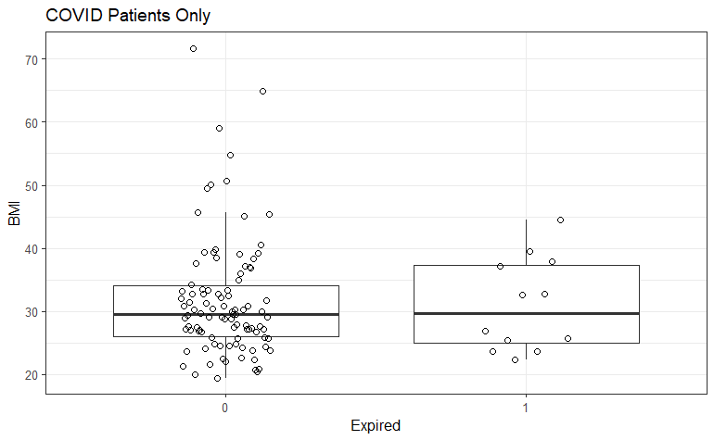
Death by OBESITY and BMI in COVID
Dead | Obese
Dead | No | Yes | Sum
No | 52 | 46 | 98
Yes | 6 | 6 | 12
Sum | 58 | 52 | 110
Death vs. Obesity Chi-square test was not significant (p>0.999)
Death vs. BMI t-test was not significant (BMI of dead = 31.0 vs. of alive = 31.7, p=0.760)

Slide 7
Death vs. ICU COVID
Dead | Critical Care
Dead | No | Yes | Sum
No | 92 | 6 | 98
Yes | 5 | 7 | 12
Sum | 97 | 13 | 110
Death vs. Critical Care (ICU) Chi-square test was significant (p<0.001)
The odds ratio of a COVID patient dying after being admitted to ICU was 21.5 compared to a COVID patient not admitted to ICU.

